Slide 1
Problem Statement
Intel Products Sentiment Analysis from online reviews…

Slide 2
Unique Idea Brief (Solution)
1. Introduction:
In this project, we perform sentiment analysis on Amazon product reviews using Python. The aim is to classify reviews as positive, negative, or neutral by leveraging natural language processing (NLP) techniques. We use various libraries such as NLTK for text preprocessing, model building, and pandas for data manipulation and analysis.
2.Key Features :
Data Manipulation and Analysis: Uses NumPy and pandas for efficient data handling, manipulation, and analysis of large datasets, providing a robust foundation for sentiment analysis.
Text Processing and Feature Extraction: Utilizes NLTK and Text Blob for text preprocessing, tokenization, and sentiment analysis, converting raw text data into meaningful features.

Slide 3
Brief Solution
1.Data Collection: Obtain Amazon product reviews using web scraping or API services, ensuring a diverse and representative dataset.
2.Data Preprocessing: Clean and preprocess the text data using NLTK and TextBlob libraries. This includes removing stopwords, tokenizing, and lemmatizing the text to prepare it for analysis.
3.Visualization:Use Matplotlib, Seaborn, WordCloud, Plotly, and Cufflinks to create visualizations that depict sentiment distributions, word clouds of frequent terms, sentiment trends over time, and comparative analysis between product categories.
4. Interactive Dashboards: Develop interactive dashboards using Plotly and Cufflinks to allow stakeholders to explore and analyze sentiment data dynamically.

Slide 4
Features Offered
1. Sentiment Distribution: Visualizes the distribution of review sentiments (positive, negative, neutral) using pie charts, bar charts, or histograms. This provides an overview of how customers perceive the products.
2. Word Clouds: Generates word clouds using libraries like Word Cloud to visualize the most frequent words in positive, negative, and neutral reviews. This helps in identifying common themes and sentiments associated with the products.
3. Sentiment Over Time: Plots sentiment trends over time using line graphs or area charts. This can reveal patterns in customer sentiments across different time periods, such as seasonal variations or responses to product launches.

Slide 5
Process Flow
1. Data Collection and Preprocessing
Step 1.1: Data Collection -Obtain Amazon product reviews data either through web scraping or API services.
Step 1.2: Data Cleaning and Preprocessing-Use NLTK and TextBlob.
2. Exploratory Data Analysis (EDA)
Step 2.1: Basic Statistics-Calculate basic statistics such as the number of reviews, average review length, etc.
Step 2.2: Sentiment Distribution-Visualize the distribution of sentiment labels (positive, negative, neutral) using pie charts or bar plots.

Slide 6
3. Model Building and Evaluation
Step 3.1: Train-Test Split-Split the dataset into training and testing sets.
Step 3.2: Model Selection-Choose machine learning models such as logistic regression, random forests, or SVMs for sentiment classification.
Step 3.3: Model Training-Train the selected models on the training dataset.
Step 3.4: Model Evaluation-Evaluate model performance using metrics like accuracy, precision, recall, and F1-score on the test dataset.
4. Visualization and Interpretation
Step 4.1: Word Clouds-Generate word clouds to visualize the most frequent words in positive, negative, and neutral reviews.
Step 4.2: Sentiment Trends-Plot sentiment trends over time using line graphs or area charts to identify patterns or shifts in customer sentiment.
Step 4.3: Comparative Analysis-Use stacked bar charts or grouped bar charts to compare sentiment distributions across different products or categories.

Slide 7
5. Interactive Dashboards (Optional)
Step 5.1: Dashboard Creation-Develop interactive dashboards using Plotly and Cufflinks to allow stakeholders to explore and analyze sentiment data dynamically.
6. Conclusion and Iteration
Step 6.1: Conclusion-Summarize findings and insights derived from the sentiment analysis.
Step 6.2: Iteration-Iterate on preprocessing techniques, feature selection, and model parameters based on feedback and additional data to improve accuracy and relevance.
Implementation in Jupyter Notebook-
In Jupyter Notebook, each step above can be implemented as a separate cell or section. Markdown cells can be used to provide explanations, headers, and text descriptions, while code cells contain the actual Python code to execute each step. Visualizations can be embedded directly within the notebook to illustrate findings and insights.

Slide 8
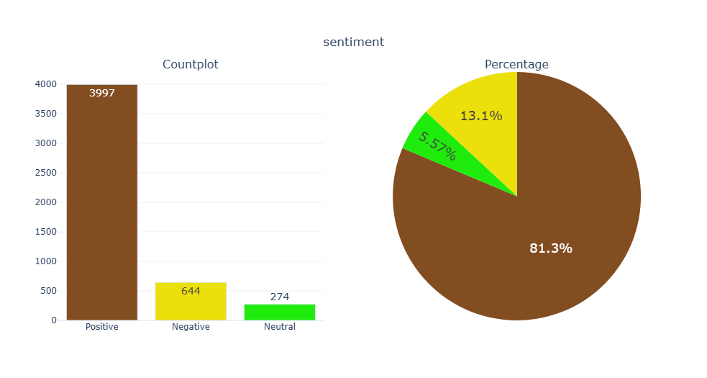
Outcome Graph

Slide 9
Technologies used
1.Python: The primary programming language used for scripting and data analysis.
2.Jupyter Notebook: Used for interactive development and documentation of the analysis process.
3.Libraries and Frameworks:
-NumPy: For numerical computing and efficient data handling.
-Pandas: For data manipulation and analysis, including handling structured data.
-TextBlob: Another library for processing textual data, including sentiment analysis and part-of-speech tagging.
-WordCloud: Used for generating word clouds to visualize frequent words in reviews.

Slide 10
-Seaborn and Matplotlib: For data visualization, including plotting charts, graphs, and histograms to depict sentiment distributions and trends.
- Plotly and Cufflinks:For interactive and dynamic visualization, including creating interactive dashboards to explore sentiment data.
4. GitHub: Used for version control and collaboration, enabling sharing of code and analysis results.
These technologies collectively support the various stages of the sentiment analysis pipeline, from data collection and preprocessing to feature extraction, model training, evaluation, and visualization of results.

Slide 11
Team Contribution
1.Harshad (Team Leader):
- Organizes team meetings and manages project timelines.
- Ensures tasks are delegated effectively and deadlines are met.
- Facilitates communication among team members and with project stakeholders.
2.Satyajit(member):
- Collects Amazon product reviews data using web scraping or APIs.
- Cleans and pre-processes data to remove duplicates, handle missing values, and prepare it for analysis.
- Ensures data quality and integrity throughout the process.
3.Suraj(member):
- Selects and implements machine learning models for sentiment analysis (e.g., logistic regression, random forests).
- Optimizes model performance through hyperparameter tuning and cross-validation.

Slide 12
4.Amruta(member):
- Creates visualizations using Matplotlib, Seaborn, WordCloud, and Plotly to illustrate sentiment distributions and trends.
- Develops interactive dashboards using Plotly and Cufflinks to explore and present sentiment analysis results.
- Designs visually appealing and informative presentations and reports for stakeholders.
5.Kiran(member):
- Conducts thorough testing and validation of sentiment analysis models and visualizations.
- Ensures the accuracy and reliability of sentiment classification results through comprehensive testing.
- Documents project processes, methodologies, findings, and lessons learned for future reference and academic purposes.

Slide 13
Conclusion
"Through our collaborative effort as a team of five students, we have accomplished a comprehensive sentiment analysis of Amazon product reviews using Python. Our project involved meticulous data collection, preprocessing, and analysis using powerful libraries such as NLTK, Matplotlib, and Plotly. By implementing advanced machine learning models and creating insightful visualizations, we successfully uncovered patterns in customer sentiment enabling us to glean valuable insights into consumer preferences and product perceptions. This experience not only strengthened our proficiency in data science methodologies but also highlighted the importance of teamwork and interdisciplinary collaboration in tackling real-world data challenges effectively."

